Slide 1
18ECO134T – Sensors and Transducers
Unit III : Session 2 : SLO 2
SRM Institute of Science and Technology
Notes:
Pl use Font Family : Arial Narrow
To enhance the teacher presentations and the overall comprehension of students, it allows to present their lessons in a more dynamic and effective way. Set a Learning Objective:
1. Write an Outline for Key Ideas
2. Give the Presentation About Education a "Why"
3. Share Techniques and Tips for the Topic
4. Teach With Visualizations
5. Use Animations Carefully

Slide 2
THERMO EMF SENSORS
Thermoemf temperature sensors are thermocouples which are most extensively used in industry, over a wide range of temperatures. The range, however, is made wide using different materials The measurement does not involve separate supply.
A resolution of 0.1-0.2°C at ambient condition is obtained which increases at high values to about +5°C.
It was discovered by J. Seebeck that when two conductors C1, and C2 of different compositions are made up into a closed electrical circuit as shown in Fig. 3.19. a small current flows through it if one of the junctions J1, has a different temperature than the other junction J2.
This current is driven as an emf is generated between these two junctions because of temperature difference. This emf is called the thermoelectric potential or the Seebeck emf which is dependent on the compositions of C1, and C2 and the difference of temperatures ϪT with the polarity depending on the sign of ϪT . For measurement of temperature, one junction temperature is held constant.

Slide 3
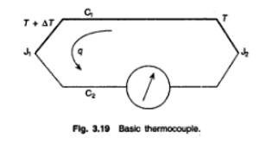
The Seebeck emf has been found to be the algebraic sum of two potentials named after their discoverers—Peltier and Thomson
The 'Peltier effect states that one of the junctions is heated and other cooled. lf a current is allowed to flow in the circuit, the amount of the temperature rise in one junction and the amount of temperature fall in the other as also which will be heated and which cooled, will depend on the current intensity and direction, besides the compositions of the conductors.

Slide 4
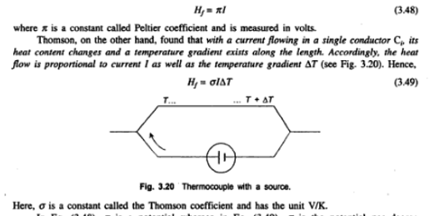
The heat flow H_{f} (power) across the circuit is proportional to current I in the circuit so that.

Slide 5
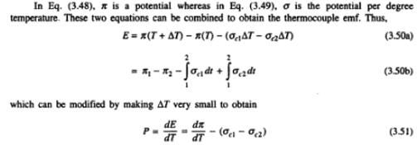
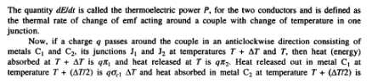

Slide 6
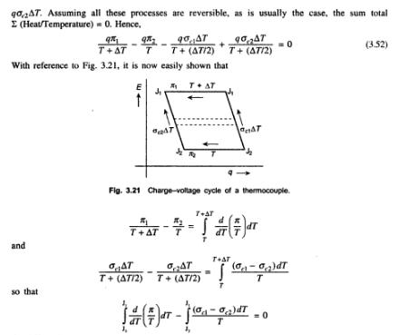

Slide 7
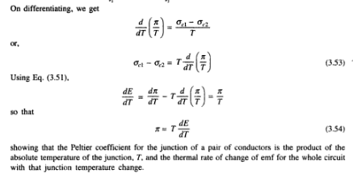

Slide 8
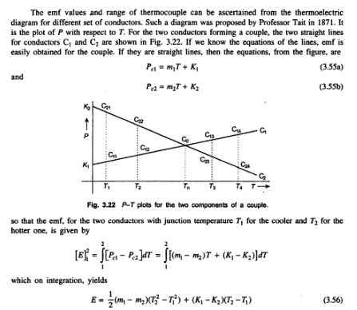

Slide 9
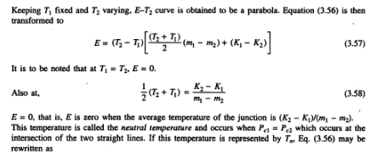

Slide 10
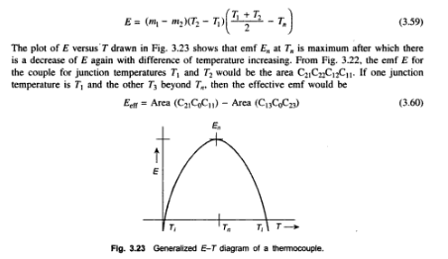

Slide 11
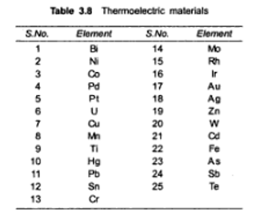

Slide 12
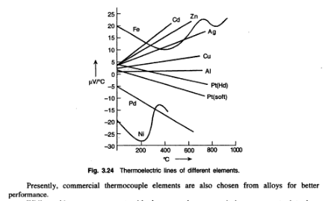

Slide 13
While making a measurement with thermocouple sensors. it is necessary to introduce measuring Instruments which therefore are likely to affect the thermoemf property of the couple. Some new junctions in effect are formed because of these insertions.
The ideal conditions leading to the thermoemf generation for a couple are rarely met in practice and more often than not empirical situations arise and calibration of the measuring system with the thermoemf transducer becomes necessary.
Some laws of the behavior of the thermocouple have accordingly been derived. These are
1. Low of Intermediate temperature: The emf for a couple. each element of which is homogeneous in constitution, with junctions at temperatures T1, and T2 is not affected by temperatures elsewhere in the circuit.

Slide 14
2. Law of Intermediate metals: If a third homogeneous metal is inserted anywhere in the couple without affecting the junctions J1, and J2 and their temperatures T1 and T2, and the new junctions of the asserted metal having identical temperature, the thermoemf of the couple remains unaffected.
3. Law of homogeneous circuits: If the circuit is made of a single homogeneous metal, no current flows through the application of heat done and no thermoemf develops.

Slide 15
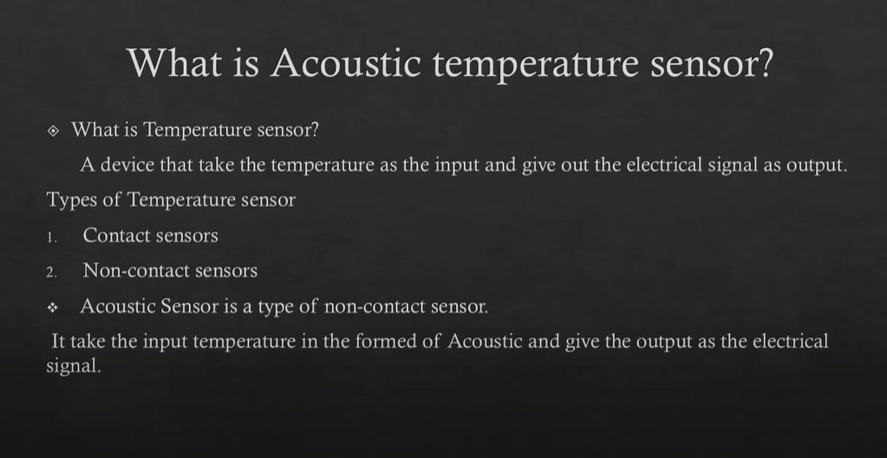

Slide 16
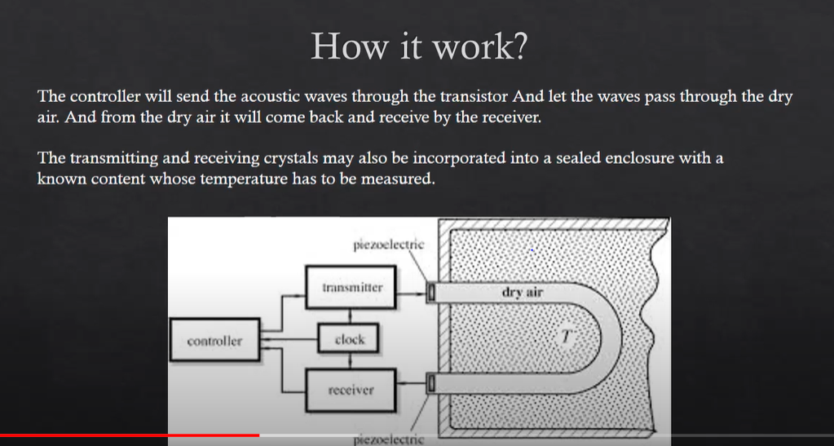

Slide 17
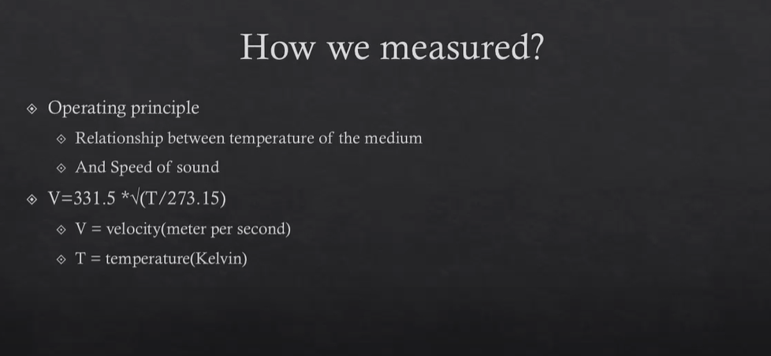

Slide 18
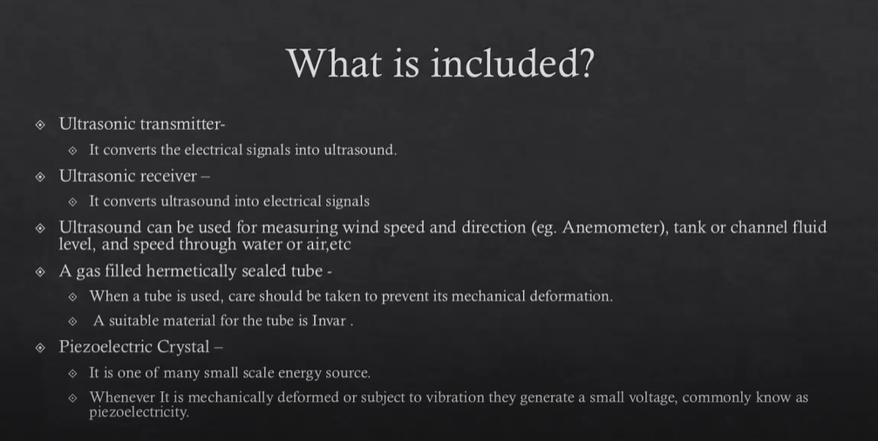

Slide 19


Slide 20
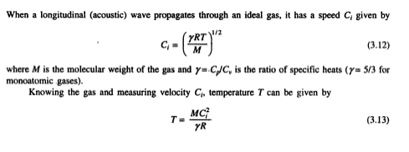
ACOUSTIC TEMPERATURE SENSOR
The realization of this technique is made in acoustic helium interferometer whose working is explained through Fig. 3.6.
A quartz crystal excited to its resonance frequency is used to transmit this wave through a gas (He) column to be faced by a piston. The wave is reflected at the piston surface to form a pattern as shown.

Slide 21
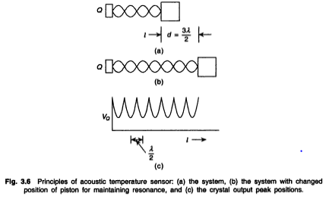
When the path length l has a multiple number of half-wavelengths and correspondingly the gas column is set to resonate at each such half-wavelength gap, with the piston moving away from the crystal at each resonant peak, the crystal gives out maximum energy and hence the voltage V_{Q} across the crystal defines peaks as shown in Fig. 3.6(c).
If the piston moves by a distance d to give n such peaks, d = nλ/2 from which C, is determined and thence temperature T. The piston movement must be accurately monitored to within, say 1 μm.

Slide 22
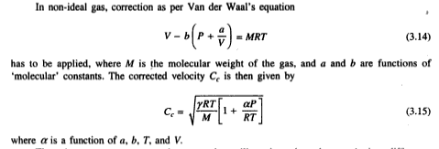
There is a nonresonant acoustic sensor that utilizes the pulse-echo transit time difference which changes with temperature. Figure 3.7 is a schematic representation of the sensory parts of the measurement system.
An ultrasonic pulse is transmitted through the sensor, a part of which is reflected at the entrance (a discontinuity) and a part at the end, as shown.
The reflected pulses are received by the transreceiver coil at an interval of called the transit time.

Slide 23
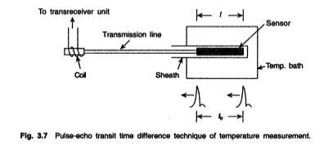
The pulse that travels the entire length of the sensor is delayed more/less depending on the change in the sensor temperature.
This temperature dependence is a function of the path length l, sensor material, temperature range, and vibration mode even if the first echo is considered.
The different materials are listed in Table 3.4 with their temperature ranges.

Slide 24
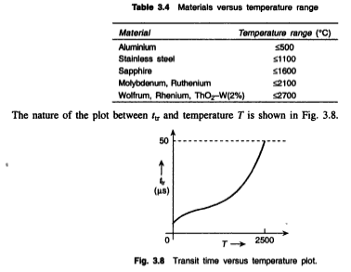

Slide 25
The sensor may be made in the form of a thin wire with restrictions or constrictions at intervals of space where the reflections would occur.
The wire diameter varies from 0.03-3 mm and spacing between restrictions varies from 5-10 mm in a sensor length of 15-50 mm, and a number of echos can then be produced.
There should not be any inhomogeneity in the material faced by the wave except for the restrictions.

